Slide 1

Lecture 3: Lambdas, File I/O & Exception Handling
WRPV301: Advanced Programming
Dr Simone Beets

Slide 2
Some admin…
Notes:
Concession letters

Slide 3
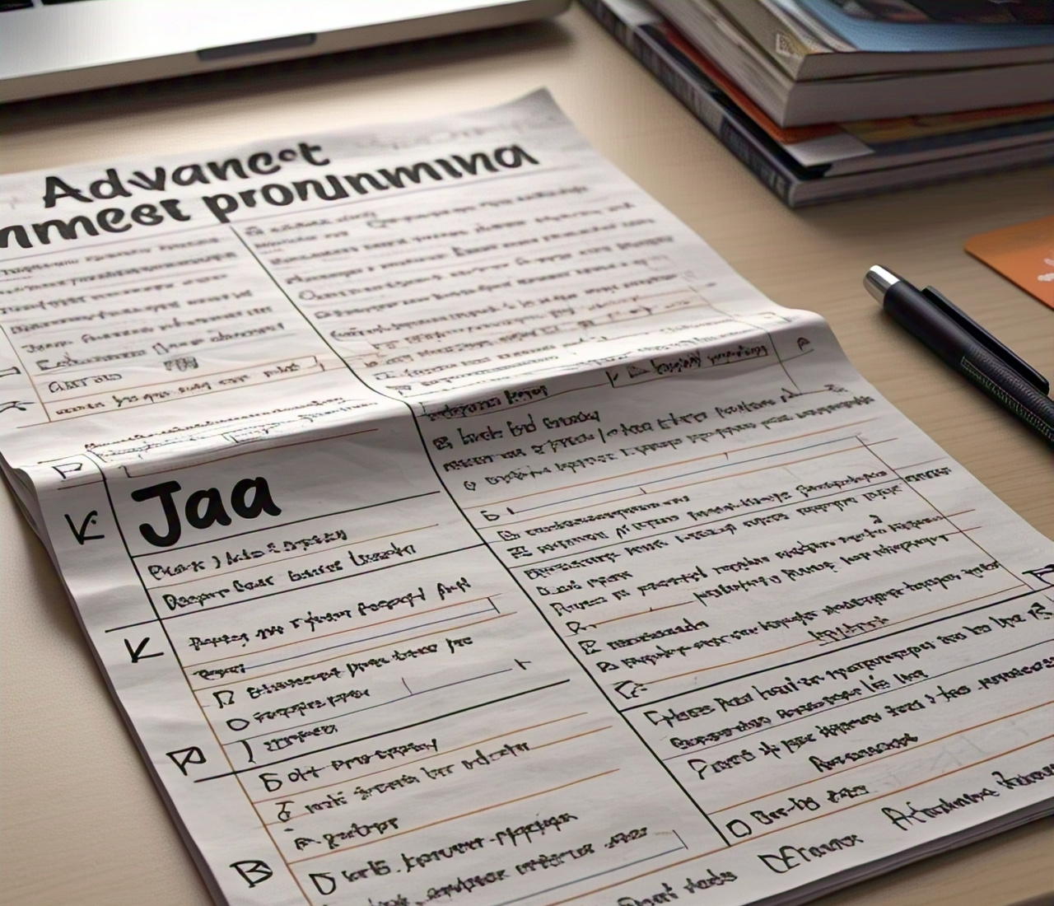
Tests & exams
Cheat sheet
Handwritten
Double-sided A4 page
Internet will be switched off in the lab for the duration of the test/exam
Why?
You can use any tool to help you prepare for assessments
BUT you should be prepared when entering the assessment & shouldn’t need any help at that point
Notes:
Image generated by Meta.ai

Slide 4
Test 1
Content
All content including next week
Theory: Quiz
MCQ, Fill in the blank, multi-select
Notes:
Image generated by Meta.ai

Slide 5

Lambdas

Slide 6

What are lambdas?
A way to write short, anonymous functions
Why would we use them?
Lambdas
To write cleaner, more readable code when working with functional interfaces
What do they look like?
(parameters) -> { body }
Notes:
What is a functional interface?
Interface with exactly one abstract method
That method will then define what you need to implement using your lambda expression
Parameters → input values like method parameters
Body is the function logic

Slide 7
Lambdas λ
In a nutshell:
Added in Java language level 8
Treats functions as 1st class “objects” (you can access & use them in same way as a variable)
Lambda expressions provide a simple, concise way of implementing single method interfaces known as Functional Interfaces
Also known as anonymous methods
“Syntactic” sugar = makes code look “pretty” & “simpler”
Collections classes (WRPV302) have been updated to make querying, using collections simpler & multi-threaded (read run across multiple CPUs)
Notes:
When working with collections, lambdas help to make it simpler especially when using multi-threaded operations

Slide 8
Lambdas λ
Read:
http://www.oracle.com/webfolder/technetwork/tutorials/obe/java/Lambda-QuickStart/index.html
https://docs.oracle.com/javase/tutorial/java/javaOO/lambdaexpressions.html

Slide 9
Lambdas λ example
@FunctionalInterface
public interface PersonSelector {
boolean isSelected(Person person);
}
// In some other class
public void displayPeople(ArrayList<Person> people, PersonSelector selector) {
for(Person person : people) {
if(selector.isSelected(person)) {
System.out.println(person);
}
}
}

Slide 10
In same class somewhere else: display everyone younger than 25
Without lambdas
// using an anonymous class
displayPeople(people, new PersonSelector() {
public boolean isSelected(Person person){
return person.age < 25;
}
});
With lambdas
// using a lambda expression: 5 lines to 1
displayPeople(people, person -> person.age < 25);
See /example03
Notes:
(parameters) -> { body }

Slide 11
Lambdas λ syntax
http://www.oracle.com/webfolder/technetwork/tutorials/obe/java/Lambda-QuickStart/index.html
http://www.drdobbs.com/jvm/lambda-expressions-in-java-8/240166764
http://www.developer.com/java/start-using-java-lambda-expressions.html
parameters
->
body
()
(int a, float b)
(a, b)
a
//Single expression (return if non-void)
{…} // multiple instructions
{
:
return <expression>; // if return
}

Slide 12
Method references
An object’s method may be assigned to a Functional Interface if the method (excluding the name) has the same signature
Use <object>::<method name> notation to obtain a reference to the method
Also works for static methods
<class>::<static method name>
See /example04

Slide 13
Method references
@FunctionalInterface
public interface Example {
int f(int a, int b);
}
public class AClass {
public int g(int a, int b) { return a + b; } ✓
public int h(int a, int b) { return a – b; } ✓
public int i(int a, int b) { return a * b; } ✓
public static int j(int a, int b) { return a / b; } ✓
public void f(int b) {…} ✗
}
// In some other class
AClass ac = new AClass();
// Obtain reference to object/class method
Example intf = ac::g; // or ac::h, ac::i and AClass::j
int n = intf.f(1,2); // same as int n = ac.g(1,2);
Read https://docs.oracle.com/javase/tutorial/java/javaOO/methodreferences.html
Question: So what will be the value of n?
Notes:
Any lambda or method reference that is assigned to Example needs to match this signature
In red: different parameters & return type
ac::g → references Aclass’s instance method g
Question: So what will be the value of n??? 3 (g has the addition)

Slide 14
Method references (continued…)
If you are writing lambda expressions of the following form:
(SomeClass obj, …) -> obj.someMethod(…)
then it may be simply rewritten as (& is equivalent to):
SomeClass::someMethod
See /example04

Slide 15
Lambdas & this
Note, in an inner, anonymous & local inner class, this refers to the instance of the inner class
In a lambda expression, this refers to the surrounding class
public class Outer {
public void f() {
Inner i = new Inner() {
public void doSomething() {
Object obj = this;
}
};
}
}
does not refer to
inner
refers to
public class Outer {
public void f() {
FuncIntf i = (x, y) -> {
Object obj = this;
};
}
}
refers to
lambda

Slide 16
Lambda limitations
Lambdas are not objects, i.e.
do not have a this
do not have a name & cannot be instantiated multiple times
cannot compare types
cannot be written to a stream (saved & loaded)

Slide 17

Class exercise
You have 5 minutes…
Instructions:
In groups of 5 (add your names)
You can use any device that you have on you but also don’t forget about chatting to each other too!
You can use any electronic source available
Use pen & paper & hand in
Questions:
Convert the provided Anonymous Inner Class into a concise Lambda.
Then, identify which part of your new code represents the 'Generic Contract’ & which part represents the 'Behavioral Implementation'.

Slide 18

File I/O

Slide 19
Streams
Console I/O
File I/O (types & formats)
File I/O

Slide 20
Streams
Source
Destination /
Sink
stream
1
1
2
2
3
3
Notes:
On the left:
You have the source of the data (so the origin)
The source can be a file, keyboard input or some other data source
For Java, we use InputStreams to read data from sources
In the middle:
Stream represents a data flow from the source to a destination
Streams are used in Java to read and write bytes or characters
On the right:
Destination or sink which is your output stream
Represents where the data is written or processed
Here we use OutputStreams in Java to write to that destination

Slide 21
Streams
output stream
input stream
App 1
App 2
input stream
output stream
same computer
across network
across internet
Notes:
Here we have two applications (represented by the boxes on left & right) that are communicating i.e.,
On the same computer
Communicating over the same network
Communicating over the internet
Arrows showing input/output streams (so bidirectional communication):
Top arrow: application on the left writes data using output stream, right application reads the data using an input stream
Bottom arrow: application on the right now writes the data using an output stream, the left application reads the data using an input stream
Data flows in both directions between the two applications using input/output streams
Note again that it can be on the same computer/machine, a local network or across the internet
Q: anyone have an example of applications where this type of communication is useful?
File transfer?
Chat applications?
Client-server model? Api communication?

Slide 22
Types of streams
Formats
Input
Keyboard (System.in)
File
Output
Screen (System.out)
File
TCP/IP connection (next semester)
TCP/IP connection (next semester)
Binary streams
0’s & 1’s
e.g., video, sound, zip
Text streams
Strings of info
e.g., txt, xml, json
Object streams
Entire objects
Keyboard (System.in)
Screen (System.out)

Slide 23
Streams
InputStream
OutputStream
FileInputStream
ObjectInputStream
FileOutputStream
ObjectOutputStream
PrintStream

Slide 24
Readers & writers
Reader
InputStreamReader
FileReader
Writer
OutputStreamWriter
FileWriter
PrintWriter
BufferedReader
Scanner

Slide 25
Console input / output
Provides “conversion” functionality
(similar to reader)
import java.util.Scanner;
public class Example01
{
public static void main(String []args)
{
Scanner in = new Scanner(System.in);
String name;
System.out.println("What is your name?");
name = in.next();
System.out.println("Hello " + name);
int age;
System.out.println("How old are you?");
age = in.nextInt();
System.out.println("Wow, that's young :)");
}
}
Input Stream
Output Stream
See /example01
Notes:
Q: What does it mean by providing a conversion??
Scanner not just used for reading in raw input
It will also convert the input into a usable data type
E.g., text input → int, double, boolean, etc.

Slide 26
Stream I/O
Process
May include read-only resource files in IntelliJ to be compiled into a final application
Create a new folder in root of Module, right-click and choose Mark Directory As > Resources Root
Place data files in this folder
From code, to obtain an input stream to a file called filename, need to use:
SomeClassInModule.class.getResourceAsStream("/" + filename); OR
this.getClass().getResourceAsStream("/" + filename);
Open/create stream
[optional] Convert stream into more “useful” one
Close stream
Read/write data
Notes:
Before reading or writing, a stream must be opened or created,
E.g., to read from a source file or from the keyboard, you’ll need to open a stream
The next step is optional, but:
Some streams can only handle raw bytes (like FileInputStream) so those streams are wrapped in higher-level classes to use them easily
E.g., wrapping FileInputStream using BufferedReader to read text easier/more efficiently
Then, when the stream is open, you can read from or write to it…
When you’re done, then you need to close the stream (.close()).
You can also include your files so that they are packaged into your final compiled output (JAR file)
Like your text files or json files

Slide 27
Text streams
All data stored as text
Same type of behaviour as when using console input & output
String manipulation important
Scanner & PrintWriter classes very useful!
For reading from a text file, see /example02
For writing to a text file (cannot write to a resource file!), see /example03
For reading and writing complex data
Need way to delimit start/end of certain data, e.g., lists
See /example04
Notes:
When you use text streams, the data is handled as plain text / human-readable characters (e.g., words or numbers)
Example formats: .txt, .csv, .json, .xml
Similar to console input/output (in reading input / printing output) except that you are reading from and/or storing to a text file
Because the data is stored as text, you might need to, and probably will, convert or split or parse the text strings (i.e., format them)
Scanner helps to read text data (and does that conversion)
PrintWriter helps to write the text data to files or wherever you need to save/write your data to

Slide 28
Binary streams
What is a byte?
Unit of information = byte
Need to do all conversions manually
String → byte[] → String
Write
Single byte or byte[]
Read
Single byte
byte[] (get told how many bytes were read)
Only way to transfer some types of data,
e.g., images, video, databases
Why use binary streams?
See /example05
Notes:
Q: definition of a byte? (Unit of information)
Text streams store data as characters, BUT binary streams store data as bytes
So there is no automatic text encoding/decoding that happens – your program just sees raw bytes
E.g., an int is 4 bytes, a char is 2 bytes
Because of this, any conversion needs to be done by you, say between data types & byte arrays
So you would say, byte[] byteArray = text.getBytes() where text is a string…
Then binary data is written in bytes or a byte array
Reading is done one byte at a time or as a byte array

Slide 29
Object streams
Reads/writes entire objects
Objects need to implement Serializable interface
Need to sync source & sink
Version of Java
Class info
See /example06
Notes:
Why do we use the word “sink” for a destination in file i/o??
Borrowed from the idea of water in a sink (basin), water flows or “sinks” into the basin
So for I/O operations, the sink is the location where the data is written or saved
E.g., writing to a file, then the file is the “sink”

Slide 30
Object streams
Issues
Versions
Object writing
written completely 1st time only
reference sent thereafter
See /example06b

Slide 31
Comparison
 | Binary File | Text File | Object File
Space usage | Very compact | Larger file size (numbers with many decimal places) | Large (stores class information)
Human readable | No (unless storing text) | Yes | No
Amount of code required | Lots | Lots | Minimal
Data definition changes | Can convert | Can convert | Cannot convert
Data validation | None | None | Type checking
Platform | Any platform | Any platform | Source & Sink Java only

Slide 32
Random access files
Sequential access only so far (i.e., in order)
Access/edit “records” out of order
File cursor that moves
Read/Write at the same time
Equal sized “records” in file only, i.e., can calculate position of any record
e.g., databases
Read Section 18.3 if interested
Notes:
Read/write at the same time:
E.g., you can read a record, edit & write to same position in a file
Equal sized records:
Program can easily calculate the exact position of a record (by: record size * index of the record)
E.g., 1 record is 100 bytes, then 5th record is at pos 500 (100 * 5)
Why databases? Record are fixed size (records = rows in a table), fast access is NB → can jump to exact position

Slide 33

Error & exception handling

Slide 34
Introduction
Throwing custom exceptions
Error handling in Java
Error & exception handling

Slide 35
Why do we need error handling in our programs?
To create programs that are:
Clear
Robust
Fault-tolerant
Notes:
To create programs that are:
Clear
Robust
Fault-tolerant

Slide 36
Introduction
Error handling code should be separated from program code
Error conditions must be dealt with

Slide 37

When to use error handling?
To handle exceptional cases
To process exceptions from other classes
To handle errors in a uniform way
Some not so great practices: ignoring them, or aborting on an error

Slide 38
Try-catch block
// code before try-catch block
try
{
// code to try and run
// might throw exception(s)
}
catch (Exception ex)
{
// if something goes wrong (exception ex)
// handle error here
}
finally
{
// regardless of what happens
// always run this code
}
// code after try-catch block
Methods throw exceptions
Exception handlers catch them
For every try block:
0..many catch blocks
done depending on if try block threw error
0..1 finally block
always done

Slide 39
Procedure for handling exceptions
If exception thrown within a try{…} block
Code immediately jumps to the 1st catch
Will proceed from catch() {…} to catch until finds one that can handle the particular exception
If finds a catch() {…} that can handle the error, then its code is executed & the error is considered handled (unless the code rethrows it or another exception – see later)
If cannot find a catch() {…} to handle the error, then the error is considered unhandled
Finally {…} block always executed (after try and/or catch)
After the try-catch block
If no unhandled exception, then code is executed as normal
If unhandled exception, then code is not executed & the method throws the exception to the code that called it

Slide 40
Example
Scanner sin = new Scanner(System.in);
System.out.println(“Enter two doubles:”);
try
{
// code to try and run, might throw exception(s)
Double x = sin.nextDouble(); // user could enter a non-number
Double y = sin.nextDouble(); // user could enter a non-number
Double z = x / y; // could attempt to divide by zero
}
catch (Exception e)
{
System.out.println(“Unable to complete operation. “ + e.getMessage());
}
finally
{
System.out.println(“Finally”);
}
System.out.println(“Completed operation.”);
See /Example00

Slide 41
Inheritance hierarchy
Exceptions are subclasses of Throwable
Throwable
Exception
Error
RuntimeException
Checked
Unchecked
Notes:
Q: What do we mean by checked or unchecked exceptions?
Describes how exceptions will be handled in code
i.e., if they need to be explicitly declared or handled by you
Throwable (superclass of all errors & exceptions)
Exception: exception conditions that your program should be able to handle
Error: used for serious errors that would not typically be handled by your program (like JVM errors)
So checked exceptions (like Exception)
Must be caught or declared in the method signature using the “throws” keyword
You have to handle them → they are expected to occur in specific situations and can be recovered
If a method throws an exception can catch in try-catch block OR must be in the method signature using the throws keyword
Unchecked exception:
Not required to be caught or declared in the method signature
So they are bugs that can’t be recovered from such as RunTimeException (logic errors or invalid input) like NullPointerException
Not anticipated
Summary:
Checked exceptions: need explicit handling
Unchecked exceptions: do not need explicit handling (BUT should be avoided/fixed in code)
For Error, e.g. OutOfMemoryError or StackOverflowError (not generally recoverable, so you can’t really handle them)

Slide 42
Throwing exceptions
To allow a method to throw exceptions
it must declare what exceptions it may throw
A method must indicate that throws an exception if
its try-catch block can throw an exception that the catches do not handle
public void myMethod() throws SomeException
{
throw (new SomeException());
}

Slide 43
Defining new exceptions
Sometimes want to define own exceptions:
Want to pass specific parameters that could be used to solve the problem
Want to handle specific types of errors differently from existing errors
class CustomException extends Exception
{
CustomException(String msg)
{ super(msg); }
}
Notes:
Q: Sometimes want to define own exceptions, when would that be?
Want to pass specific parameters that could be used to solve the problem
Want to handle specific types of errors differently from existing errors

Slide 44
Defining new exceptions
Should select an appropriate subclass
class DivideByZeroException extends ArithmeticException {
DivideByZeroException()
{ }
}

Slide 45
Defining new exceptions
How to use your custom exception?
See /Example00a
int divide(int num1, int num2) throws DivideByZeroException { if (num2 == 0) throw (new DivideByZeroException()); return (num1 / num2); }

Slide 46
Defining new exceptions
Sometimes necessary to defer exception handling to the next enclosing try-catch clause
i.e., the method calling the current method should do the exception handling
An exception can be re-thrown inside a catch clause by calling:
throw exception;
If an exception is thrown from within a catch() {…} block:
the other catch blocks do not attempt to catch it (it is thrown out of the try-catch block & is considered unhandled)
See /Example00b
See /Example00a

Slide 47
Assignments
Assignment 2:
Upload by end of this week
Due - check the schedule
Assignment 1:
Due tomorrow; peer review by Friday

